Slide 1
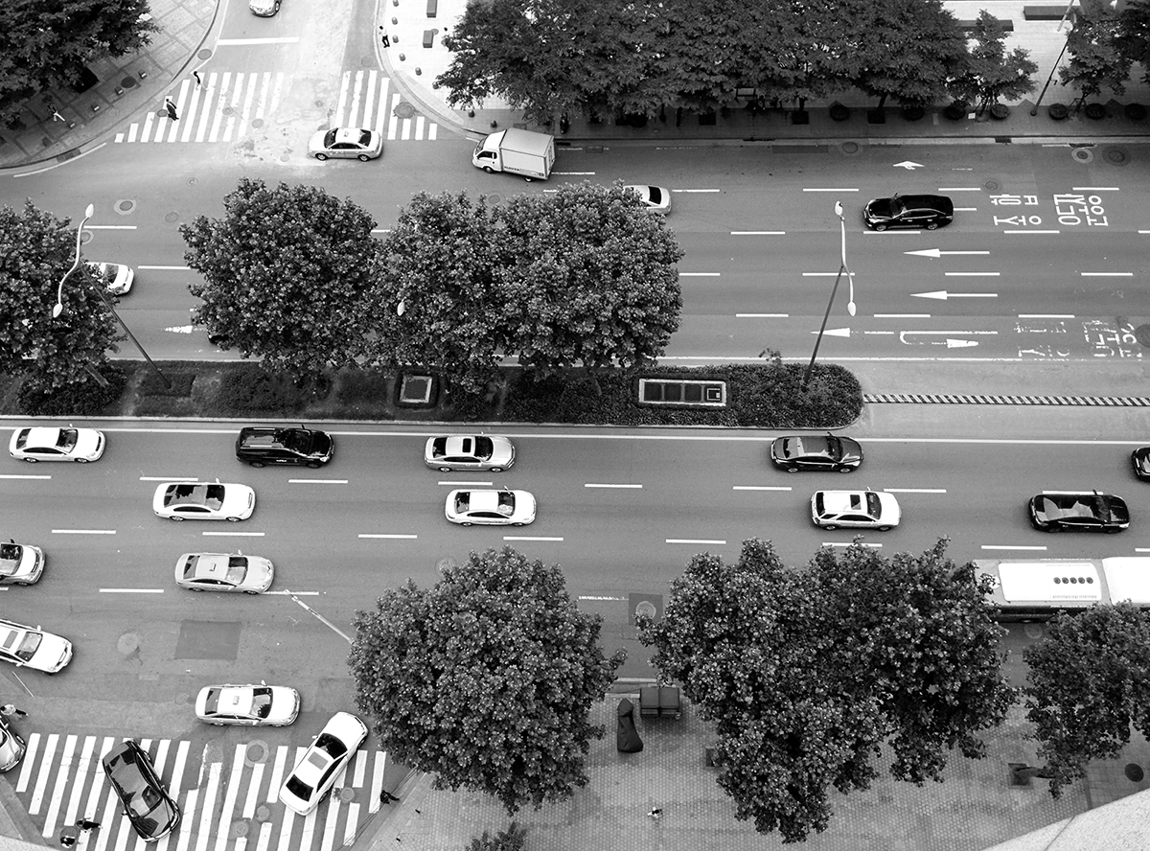
Project Kalexa with AWS
Creative Integrated Design, 2016 Fall
[Group D] Yeongjin Choi •Junhyuck Kim•Sanghoon Lee
Channy Yun (AWS, Tech Evangelist)

Slide 2
Contents
Table of Contents
Overview
Goal/Problem & Requirement
Approach
Development Environment
Architecture
Implementation
Result
Division and Assignment of work
Demo

Slide 3

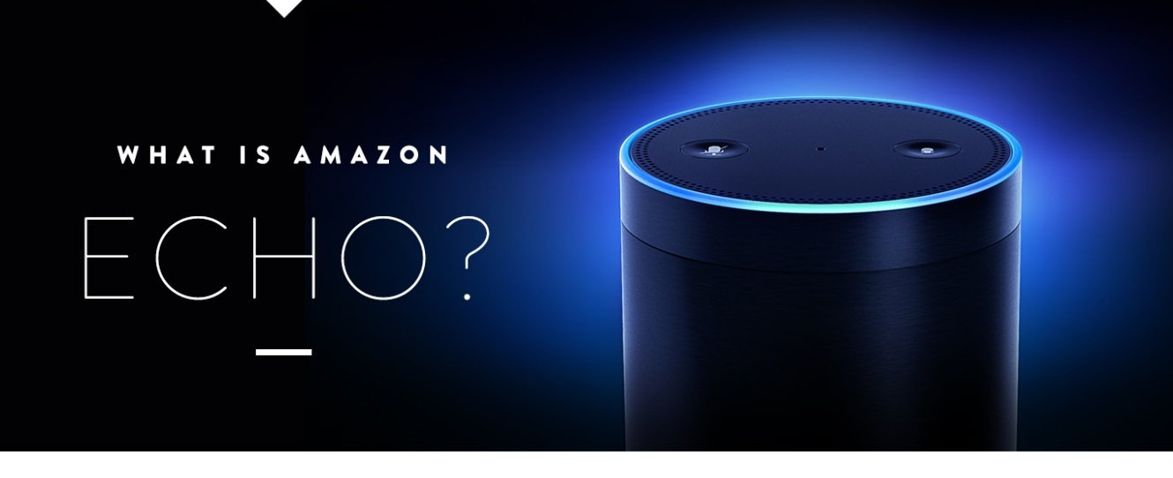
Amazon Alexa Echo
Overview

Slide 4
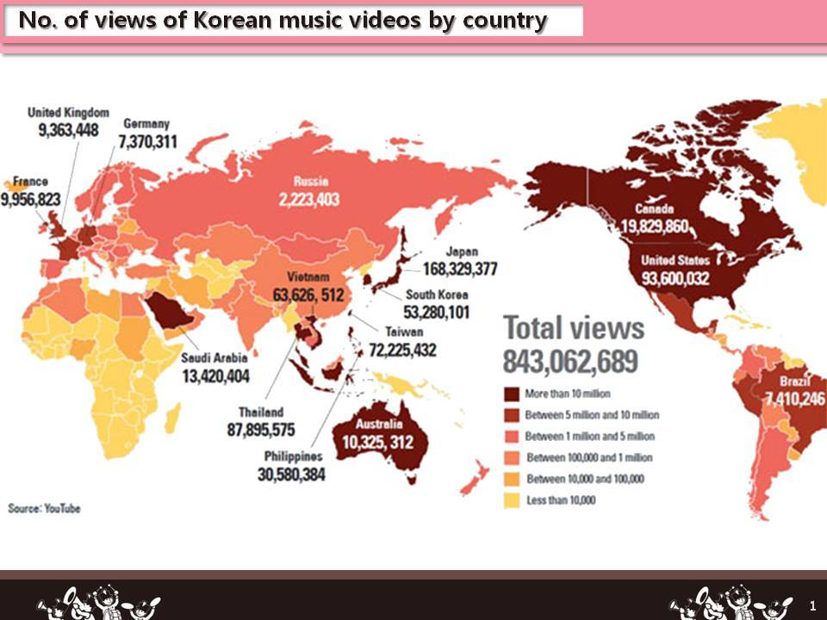
Motive
Overview

Slide 5
Project Kalexa
Goal & Requirement
Learning Korean
Translation
Quiz
K-POP Information
K-POP chart information
Lyrics
Play songs
Music Recommendation
Emotion based
User based

Slide 6
Project Design
Approach
Basic Implementation
Challengeable
Amazon Web Service
Translate API
Text to Speech API
Melon API
ffmpeg
Scalability
Performance
Accuracy
Recommendation

Slide 7




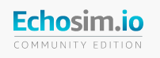

Platform & Tools
Development Env.

Slide 8
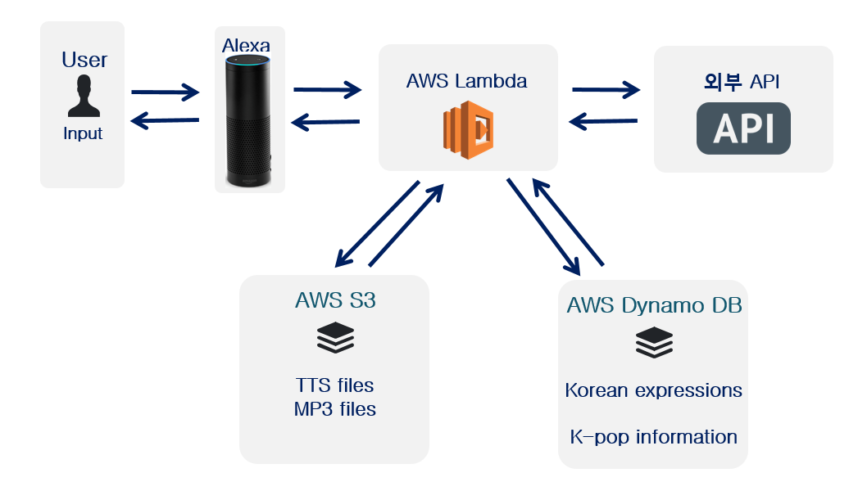
Architecture Design
Architecture
Skills
Naver / Google / Melon API
Node.js Packages
FFMPEG Library

Slide 9
Features
Implementation
By midterm presentation
Translate XXX into Korean
I want to know popular K-POP songs
Play nth song in the chart
Let me know other song of nth artist
I feel sad
New features
Recommend me any song
Give me n Korean quizzes
Tell me the lyrics of nth song
[Prompting]
…and, significant improvements on Accuracy & Performance

Slide 10

Scalability Recommen-dation
Implementation
K-POP Music recommendation
Pre-defined set for emotion based
Collaborative filtering
Recent playlist
Popular playlist

Slide 11
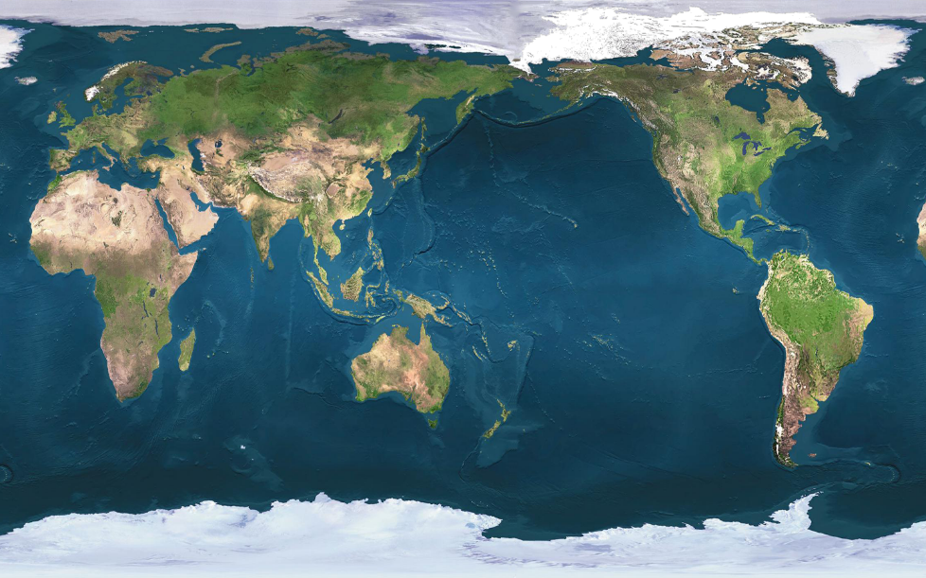
Accuracy
Implementation
Causes of Alexa request failure
Voice recognition
Utterance conflict
Device timeout
Long latency due to AWS location
Lambda initialize
Other performance tunings

Slide 12
Performance
Implementation
Latency in API calls
Reduce calls, Dummy worker, Caching, Google
Lambda Initialization
User library tuning to Amazon Linux
Lambda Execution
Efficient code, MP3 caching
Using Redis – In-memory Cache
Alexa Timeout

Slide 13
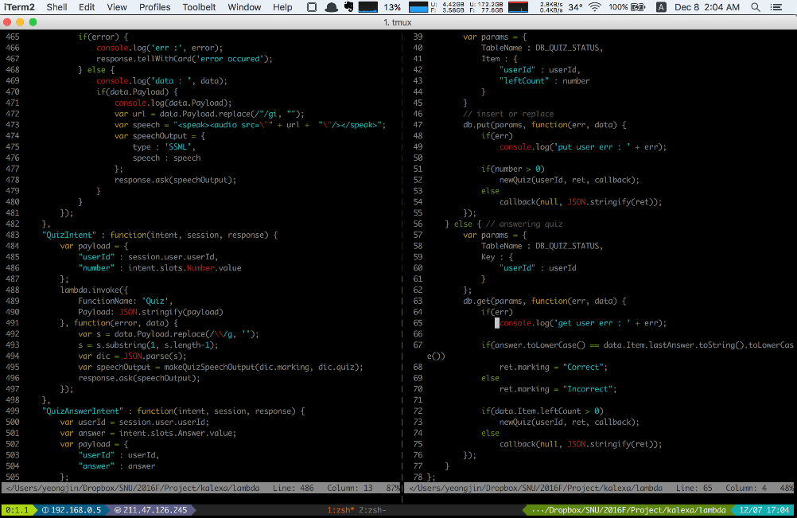
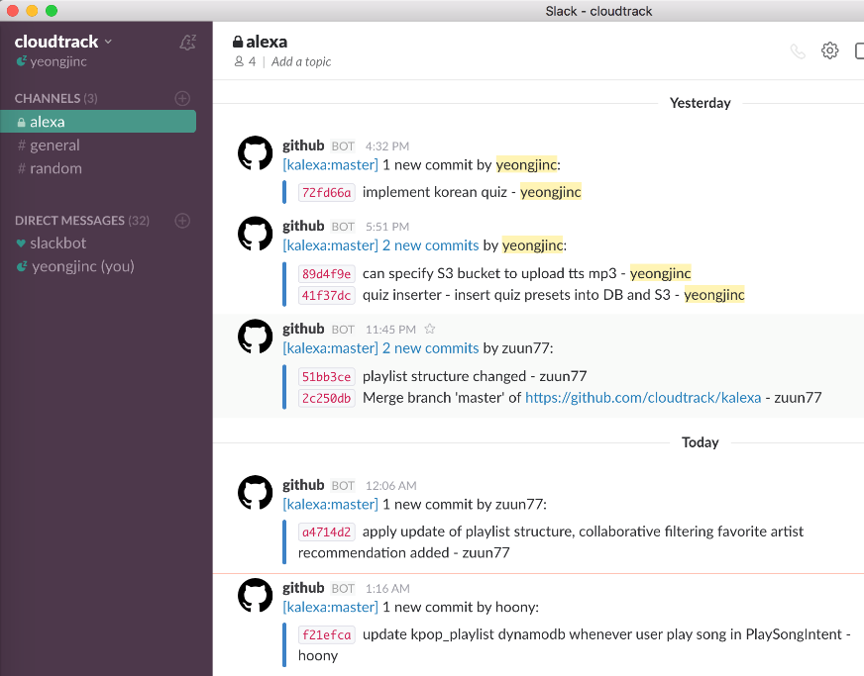
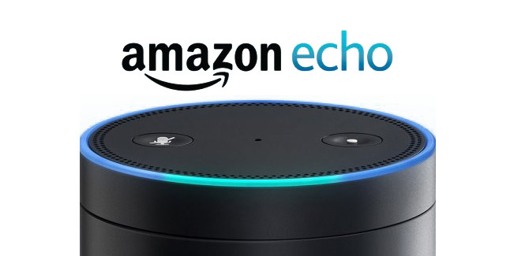
Output
Result

Slide 14
Limit Future Plan
Result
If Alexa itself start to support Korean?
Cannot parse sentences not in predefined set
Detailed Recommend
Profound Quiz
Failover
Refact-oring
Other
Contents

Slide 15
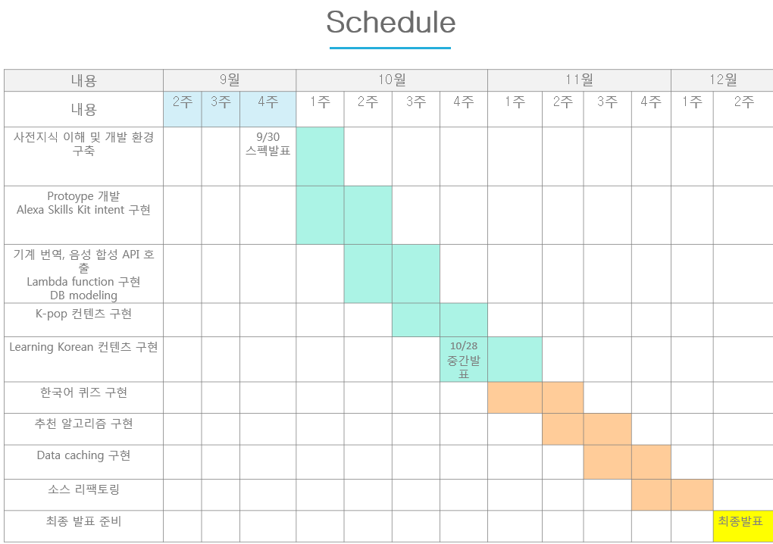
Schedule Role
Division & Assignment
Alexa Skills Kit Intent 및 Utterance 설정 | 팀 전원
기계 번역/음성 합성 API 호출 Lambda Function 구현 | 최영진
Ffmpeg 라이브러리 포팅 | 최영진
DB Modeling | 팀 전원
Learning Korean 서비스 구현 | 최영진
차트 정보 조회 기능 | 이상훈
아티스트의 다른 앨범 및 노래 조회 기능 | 이상훈
가사 출력 | 김준혁
감정 상태에 따른 곡 추천 | 김준혁
추천 알고리즘 구현 | 김준혁
Data Cache 구현 | 이상훈
문제 해결 | 팀 전원

Slide 16
Execution of Project Kalexa
Demo
Learning
Korean
Translate
Quiz
K-POP
Information
Chart
Lyrics
Play
User
Based
Emotion
Based
Recommendation

Slide 17

Backup Plan
Demo
Video
In USB
https://www.dropbox.com/s/4de23evxntetsdd/Kalexa_resize.m4v?dl=0
If neither network nor USB stick works…

